Slide 1
Software Engineering 2
PowerEnJoy
ZHOU YINAN
ZHAN YUAN
ZHAO KAIXIN

Slide 2
Introduction
Key Topics today
RASD
DD
ITPD
PP

Slide 3
RASD
Note : • Guest : A potential user who has not registered yet
• User : Logged in clients
register
start renting
Guest
User
Reservation
Car
end renting
log in
money save option

Slide 4
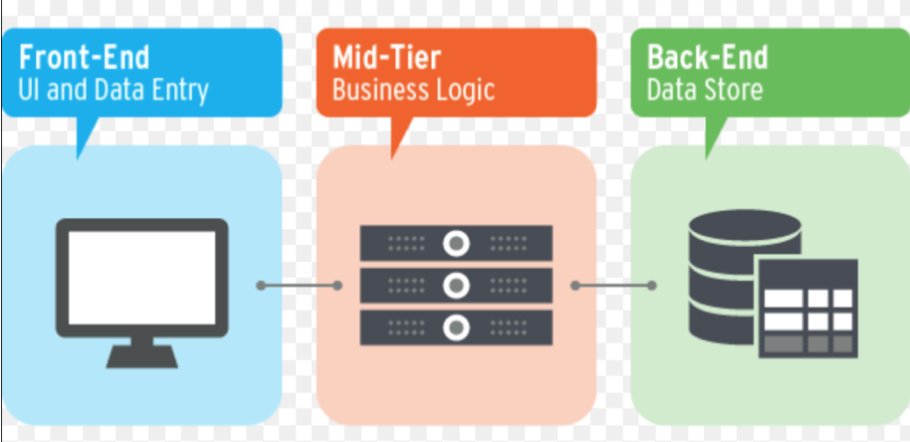
DD
Three Tier
Request-Response
Business Logic Layer : • User Manager
• Guest Manager
• Car Manager
• Database Manager

Slide 5
ITPD
Guest Manager
Data Base Manager
Bottom Up
User Manager
Car Manager

Slide 6
PP
ILF
EIF
INPUT
Inquiry
OUTPUT
User
Bank Service Gateway
Log in/ Log out
Retrieve Info
Notification
Car
Google Map Gateway
Register
Get Available Cars
Ride
Gmail Gateway
Reserve
Get Safe Areas
Reservation
Unlock door
Get Discount&Punish
DiscountAndPunishment
Start Ride
End Ride
Modify Info

Slide 7
Design Document

Slide 8
Managers
Guest Manger
Car Manager
Register, Log in
Unlock door
Show current charge
Start renting, End renting
Discount and Punishment
Save money option
User Manager
DB Manager
Reservation
Find location of available cars
Cancel reservation
Basic interactions with database

Slide 9
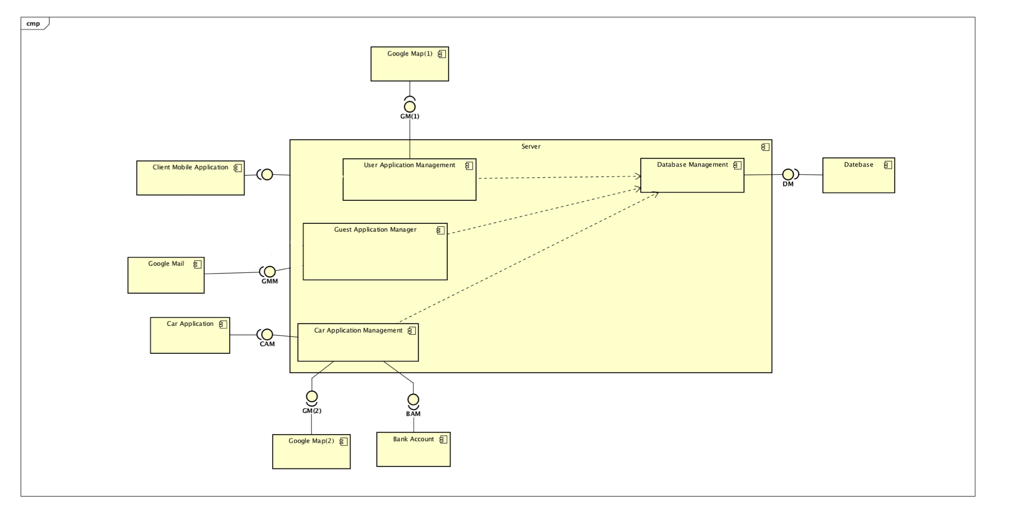
Component view

Slide 10
Runtime view of registration

Slide 11
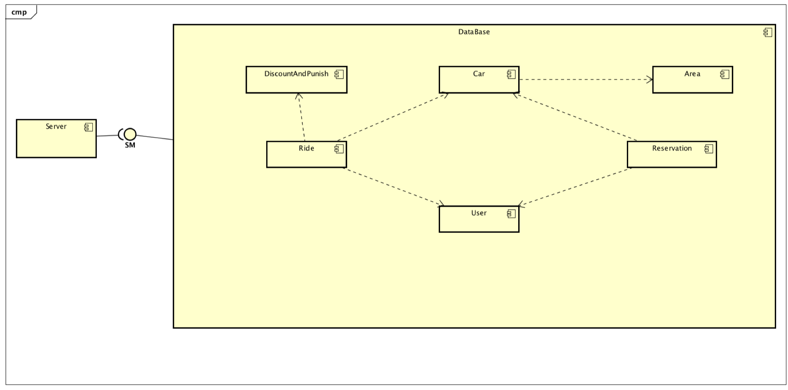
Database table
01
User
02
Car
03
Reservation
04
Ride
05
Discount and Punishment
06
Area

Slide 12
Class diagram

Slide 13
ITPD && PP

Slide 14
ITPD
Bottom Up
The approach we choose in this project
From the component Database
Testing base on the component Database Manager

Slide 15
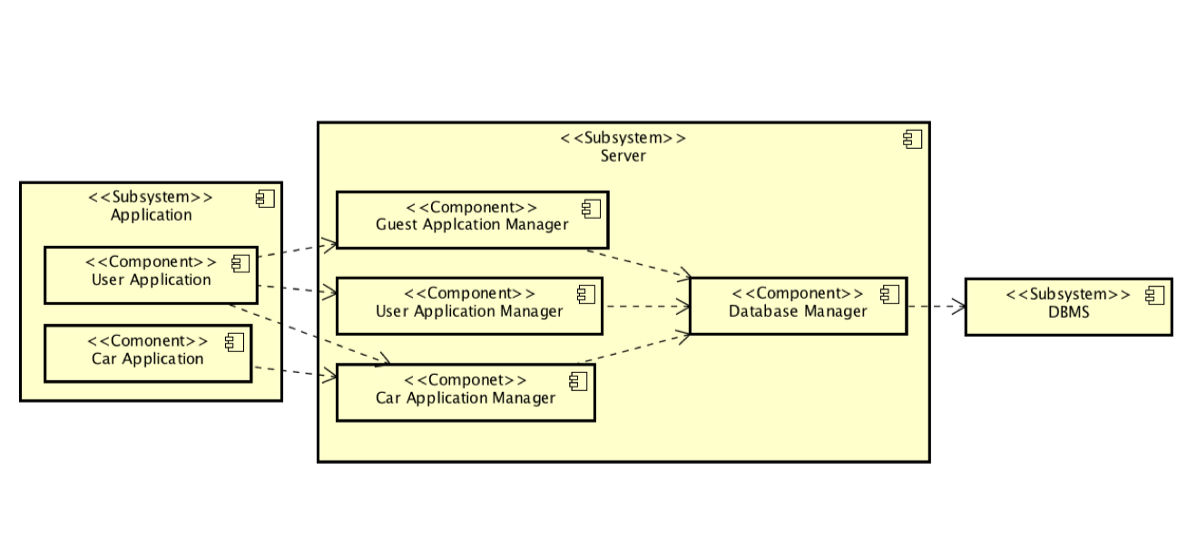
ITPD
SubSystem View
Guest Subsystem
User Subsystem
Car Subsystem
(Showed in the Document)

Slide 16
ITPD
Partial Test Description
Guest Application Manager & Database Manager
User Application & Guest Application Manager

Slide 17
ITPD
Component | Functions to be unit tested
Guest Application Manager | Boolean register()
 | String signIn()
 | String register()
User Application Manager | car[] getCarAvailable()
 | String setReservation()
 | Reservation[] getListActiveReservation()
 | String cancelReservation()
 | void reserve()
Car Application Manager | Boolean startRide()
 | Boolean updateRide()
 | Boolean insertCar()
 | Boolean deleteCar()
 | Boolean insertSafeArea()
Here lists some
Functions should
be unit tested
(1/2)

Slide 18
ITPD
Here lists some
Functions should
be unit tested
(2/2)
Component | Functions to be unit tested
Car Application Manager | void openTheDoor()
 | void startRide()
 | void endRide()
 | String getCurrentPrice()
 | void variationCost()
 | void sendMsg()

Slide 19
ITPD
Here lists some
Functions should
be unit tested (Interaction with external components)
Component | Functions to be unit tested
Guest Application Manager | Boolean sendMail()
User Application Manager | Boolean sendMail()
 | double[] findCoordinates()
 | Map getMap()
Car Application Manager | Boolean sendMail()
 | double[] findCooedinates()
 | Map getMap()
 | String payment()

Slide 20
PP
COCOMO 2
^{Scale Drivers}
^{Precedentedness:Low}
^{DevelopmentFlexibility:Normal}

Slide 21
PP
COCOMO 2
Cost Drivers
Required Software Reliability (RELY) : High
Required Reusability (RUSE) : Nominal
Storage Constraint (STOR) : Nominal

Slide 22
Question and Answer
Thank you

